Slide 1





Young people research
Findings and recommendations
Notes:
We're Hitch, a social marketing agency. We were commissioned by WMTG to carry out insight work with young people aged 18-21 in Wrexham.

Slide 2
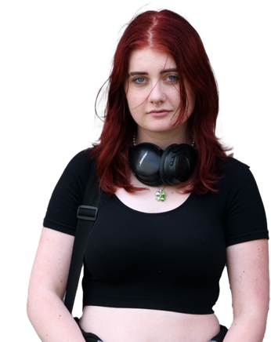
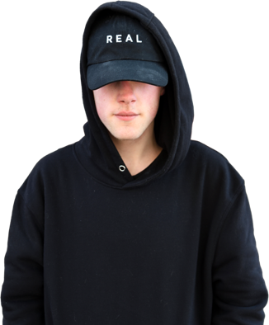
Content
The start of the journey
Finding the missing voices
What did we learn?
Who are the young people of Wrexham?
End of a chapter, start of a new one
Notes:
Many of you were with us at the start of this journey, so you’ll be familiar with what our aims were. We’ve brought you together so that we can discuss our findings and to hopefully rally support for the moving forward in creating a bright future for young people in Wrexham.
The presentation will cover how we found the missing voices of young people aged 18-21, what we learned, exactly who the young people are, and we’ll talk about how this first chapter leads us into the next.

Slide 3
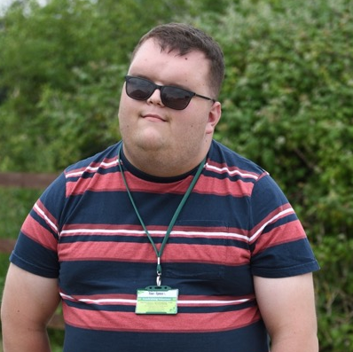
The start of the journey
Launching the Big Conversation
Notes:
We started this research with an idea that things weren’t right for young people, generally. Research tells us that young people in the UK have been impacted by recent events- the covid pandemic, the cost of living crisis, concerns about climate change- in a greater way than we probably imagined.
We know that their educations have been disrupted, that the systems which offered them security were shut down, and that they lost out on a big chunk of life-experience. And now we want them to go back to normal.
Preliminary findings of new research are telling us about the outcomes of young people, but we wanted to get a clearer idea of the local picture.

Slide 4
Launching the Big Conversation
As we continue to grapple with the the long-term effects of the last decade’s events - particularly the COVID-19 pandemic and the cost-of-living crisis, more and more light had been shed on the profound impact those events have had on younger generations.
We know the facts
We know the numbers

Slide 5
WHAT WAS OUR
CHALLENGE?
Notes:
What was our challenge? What did we want to achieve and what were our objectives?

Slide 6

Objectives: what we wanted to achieve
In one sentence, we wanted to understand the lives of young people (18 to 21) in Wrexham and how we could support their needs.
To do so, we aimed to:
Understand what it is like being young person
in Wrexham.
Explore what the challenges are and where
they may lie (if they exist).
Understand what facilitates or inhibits young people to achieve their full potential.
Identify recommendations to better engage
with this audience.
Notes:
Basically, we wanted to understand the lives of young people aged 18-21 in Wrexham and how we could support their needs.
We wanted to understand what it is like to be a YP in Wrexham
We wanted to explore the challenges that YP might face
We wanted to understand how YP can be supported to reach their full potential
And we wanted to identify ways in which we- and you- can better engage with YP of Wrexham

Slide 7

Finding the missing voices
Research phase and data collection
Notes:
Very briefly speak about the research phases- the full report details the methodology, the results with all the quantitative stats and the themes from the qualitative data.

Slide 8





Methods: How were we going to find young people?
Phase 1
The Big Survey: “Hearing what young people have to say”
Phase 2 to 4
Young people’s focus groups
Phase 5
On-street engagement: going where young people are
Phase 6
Digital entries
– Wrexham voices
Phase 7
Parent and teacher insight
Notes:
Any time we carry out insight work into any human behaviour, we apply tried and tested methodology. Because of the nature of this research, we found that we needed to be flexible with our methods. There will now be a quick overview of each on of these 7 phases.

Slide 9
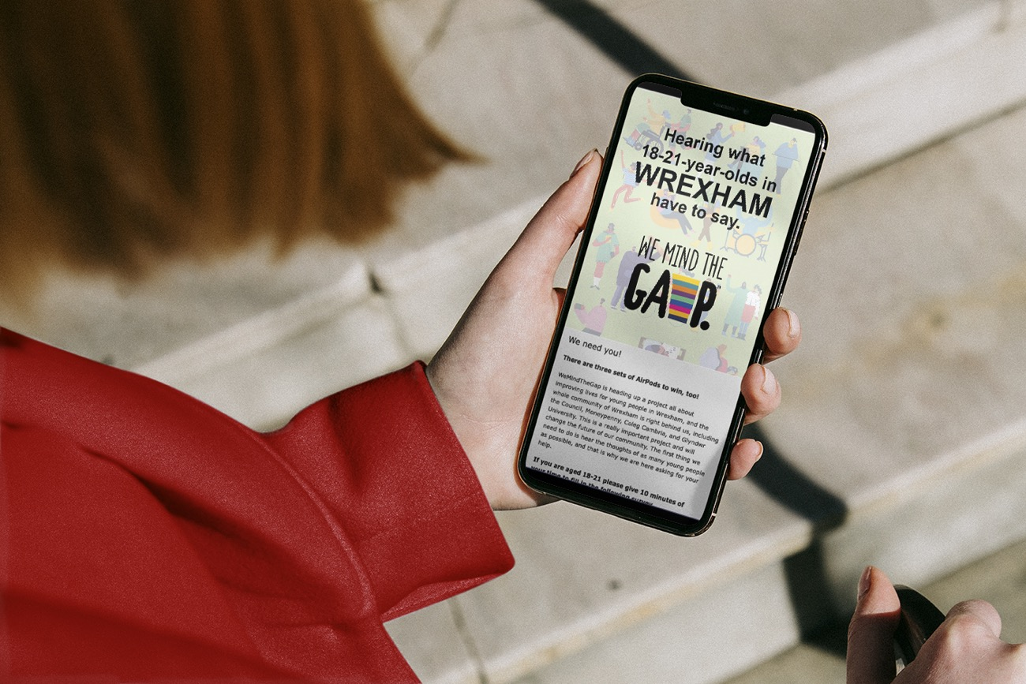

Phase 1: The Big Survey:
Hearing what young people have to say.”
Our starting point a survey, to give us a chance to introduce the project, recruit and reach young people anywhere.
Responses could be anonymous, the survey was short, easy to fill and could be saved and completed in several parts to make it as accessible and engaging for young people.
Notes:
We started with a large survey which we distributed widely. This allowed people to give their views anonymously and quickly.

Slide 10
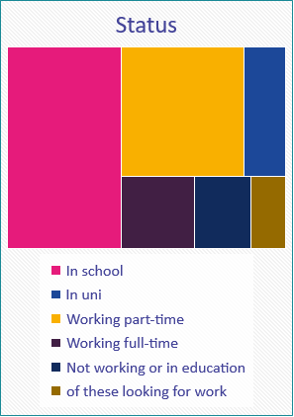
Results and demographics
219
COMPLETIONS
We asked young people about their daily lives and how they spent their down time, mental wellbeing, goals and aspirations, support networks and how the pandemic may have impacted these.
We asked young people about their daily lives and how they spent their down time, mental wellbeing, goals and aspirations, support networks and how the pandemic may have impacted these.

Slide 11
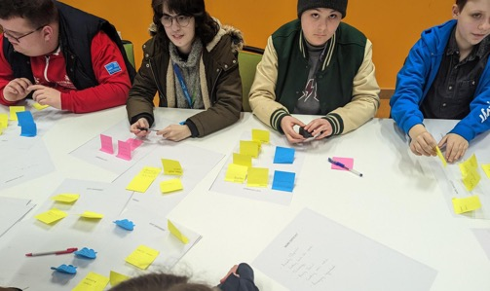
Phase 2, 3, 4:
Young people’s focus group
We organised focus groups at Coleg Cambria as well as Maelor sixth form where we spoke to students aged 18 to 22.
We also hosted an online focus group where we spoke to young people who were not in school or education in Wrexham.
Notes:
We realized that a survey can only give us so much detail, so we carried out focus groups, too- this allowed us to speak directly to young people and engage them in co-designing elements of the research. Thanks for Maelor sixth form and Coleg Cambria for welcoming us and facilitating this research. We also held a group for young people who were not in education or employment to make sure we were speaking to a representative sample.

Slide 12
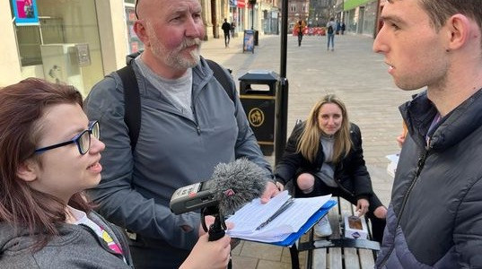
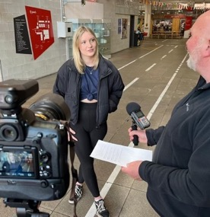
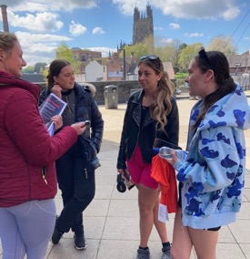
Phase 5: On-street engagement: going where young people are
We knew we could not rely on developing content and hoping young people would find us. We needed to be the ones to find them, to reinforce how much we cared.
Notes:
We also took to the streets and various events that young people attend, carrying out surveys and short interviews.

Slide 13

Phase 6: digital entries
The data we got on on-street was invaluable. We could not miss out on feedback from people who might not want to speak to us in-person. Our digital entries asked the same questions we were asking on-street, allowing people to anonymously reach out to us by writing down or recording their thoughts.
Questions were broad and there was no word limit giving more in-depth and less led answers than in the survey. Some people later agreed to speak with us over the phone where they were able to expand on some of what they had shared in their entries.
Notes:
For people who were reluctant to speak to us, we developed an online platform that allowed them to upload their views in text, audio or video format. These were still anonymous, like the survey, but offered the chance for more qualitative data to be collected.

Slide 14

Phase 2, 3, 4:
Parent and teacher’s focus group
Finally, we spoke to parents and teachers across Wrexham to understand their perspective on some of the issues young people were raising.
Notes:
And, finally, because we know the importance of gaining insight from parents, teachers, and other stakeholders, we carried out some insight with these groups, too.

Slide 15
Emerging themes
Themes started to emerge including:
Increased social anxiety
Mental health struggles
Rise of addiction
Feeling unsafe in Wrexham
Strong awareness of social issues of today
Wanting to lead meaningful and fulfilling lives
We had managed to reach a wide range of young people in Wrexham, especially students, but were still missing data from other key groups of young people.
Where could we find them?

Slide 16
Phase 5: On-street engagement: going where young people are
We knew we could not rely on developing content and hoping young people would find us. We needed to be the ones to find them, to reinforce how much we cared.
We attended events including festivals, council-led initiatives,
in the town centre, Wrexham’s surrounding areas, in pubs, sports centres, nail salons; anywhere
we suspected young people
might gather.
We managed to speak to 83 young people, but a lot of them told us, again, that on-street would not be where we managed to reach most young people. Many confessed they had friends who developed social anxiety or lost all motivation.

Slide 17
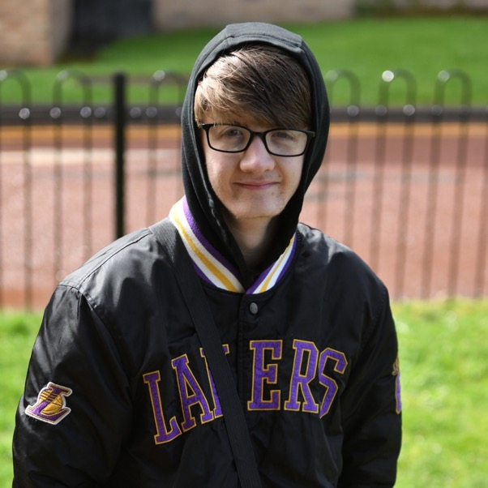
So… what did we learn?
Analysis and findings
Notes:
What did we learn? The full report details all of the findings and covering them all is beyond the scope of today’s presentation, but hopefully you’ll have a ”flavour” of what came out of the research.
Throughout the rest of the presentation, you’ll see the faces of the young people we spoke to, you’ll hear their voices, their opinions and their thoughts and feelings. We hope this will inspire you in the same way it has us.

Slide 18
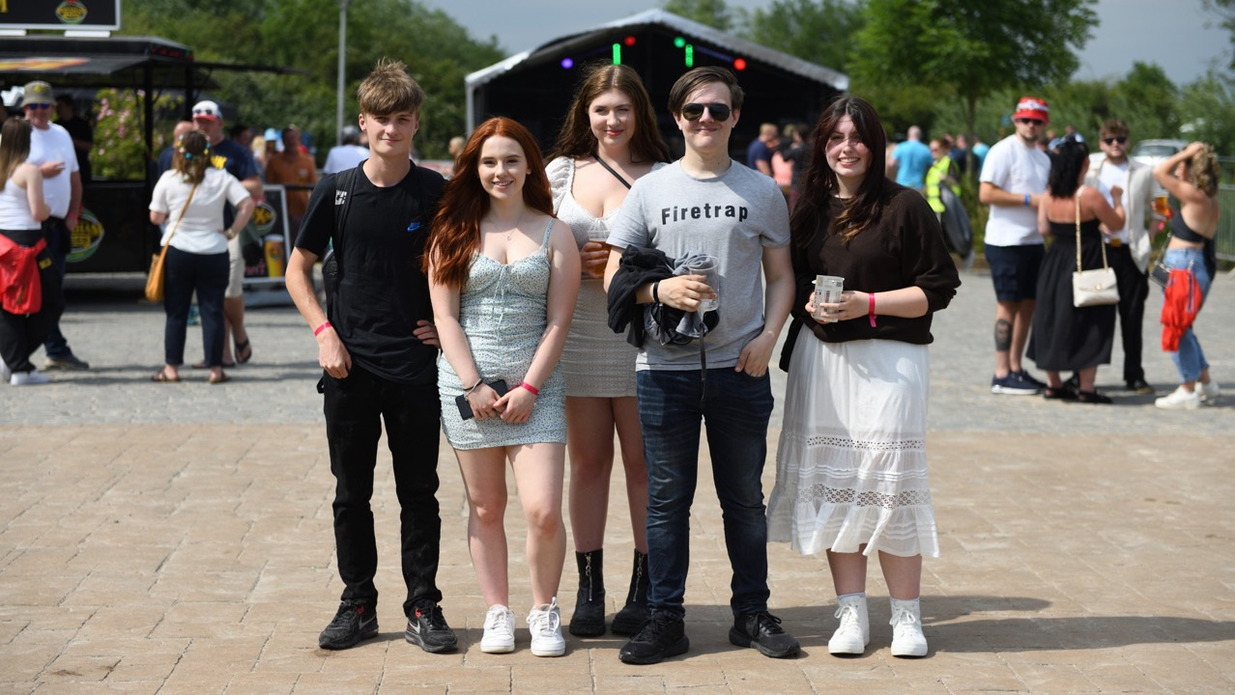






My short-term goals are to move to Leicester to complete my 3 years of dance university, My long-term goals are to have my own dance studio local in Wrexham to help young kids find their passion and talents.
I want to be able to spend time with my friends and family. Enjoy days out and good food without money worries.
I think it’s made me more anxious; I struggle to find motivation to do work.
I am a lot more anxious now than I was before covid. Therefore, impacts me with some normal life activities and hits me when least expected.
To buy my Dream house in the country with a big garden and build my dream pond with fish in it and to work in a park ranger job that pays well.
I missed out on key knowledge I could have learned if it was in the normal conditions.
Notes:
Here are some of the themes that emerged. Young people told us that they feel more anxious than ever. They have mental health struggles that they haven’t experienced before the lockdowns. They feel lonely and isolated and they often feel unsafe in Wrexham.
On the flipside, however, young people told us that they have dreams of living meaningful; and fulfilling lives and that they have a strong sense of awareness of today’s social issues. YP want to be heard, but often don’t feel that they are.
NEXT you’ll hear the voice of Emma, one of our young people, who expressed her challenges following COVID.

Slide 19
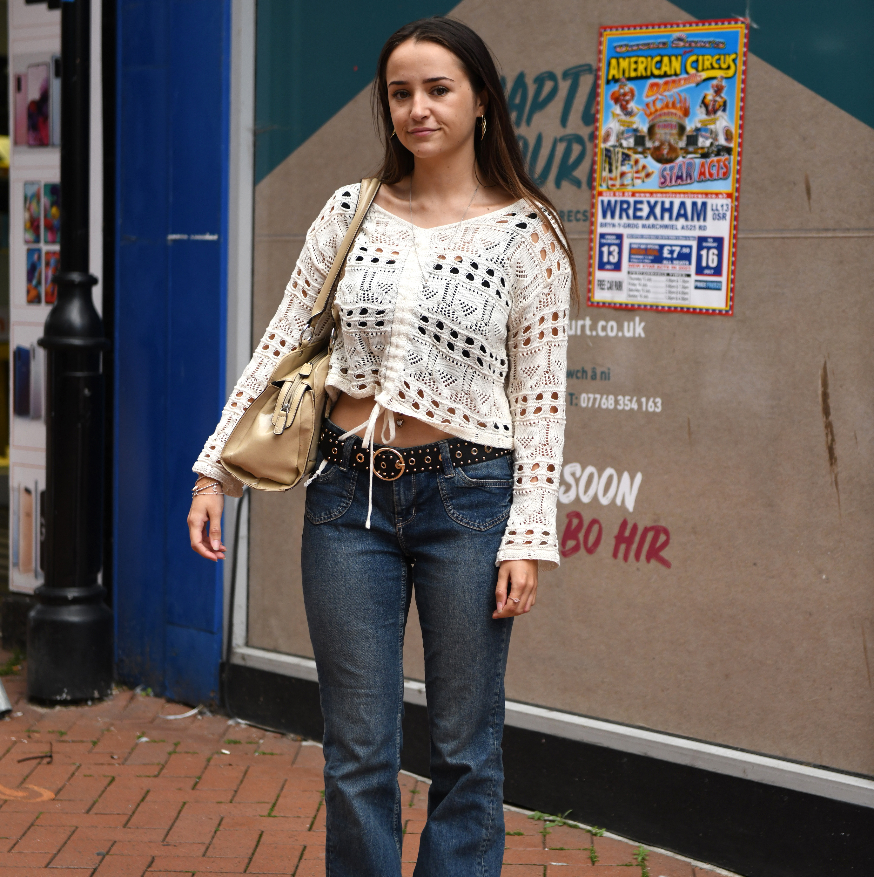

A day in the life of…
Emma
Notes:
Play 'Emma'

Slide 20
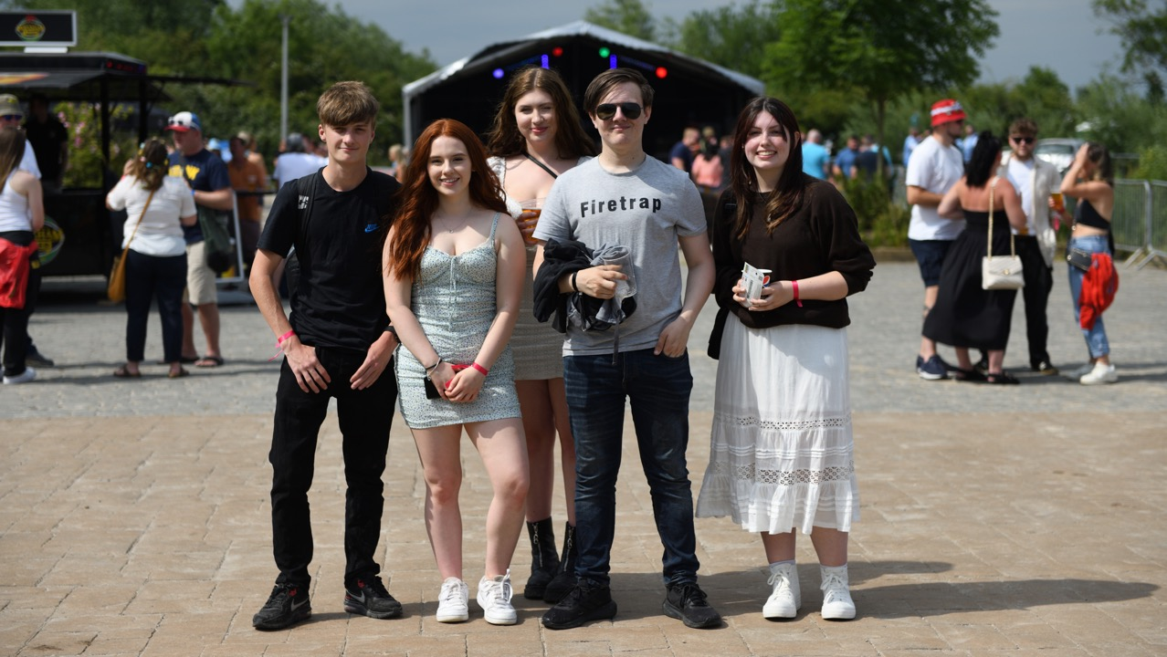



Phase 6: digital entries
It's really tough down here, lack of funds and support is really draining me.
I panic when something changes. My worries for said goal is that if it were to suddenly change then I wouldn’t be able to cope with change.
I worry that I won't be able to afford the cost of living with the wage that I am on.
…long-term goals would probably be to not be insecure in my abilities and work to improve them, also getting a permanent job that pays, so I can finally stop sponging off my parents.
Also, what happens if my parents get ill, will I be able to look after them?
I’ve never been able to find out what I would like to do.
Notes:
These are some of the quotes we took from the online platform we developed for YP to give us their views.
As you can see, they have a lot to tell us. They feel worried and anxious about the future, they’re concerned about finances, and they feel directionless. (Leave slide for a few moments to allow audience to read).

Slide 21
Parent and teacher insight
This perspective confirmed the disconnect between young people and those who support them, as well as the system they are a part of.
Communication between families and schools was seen as crucial, to push and support young people before they disengage.
A clear need to support young people to “catch up” on skills they might have lost through the pandemic (social skills training, time management, resilience building) was also identified.
Young people said they had aspirations but not traditional academic and employment aspirations.
Young people felt they had been held responsible for recent events (e.g., covid spread)
Young people felt existing services were not accessible, approachable, or appropriate
Parents and teachers felt young people lacked aspirations
Parents and teachers thought young people seemed unaccountable
Parents and teachers felt young people did not want to utilise existing support services
Notes:
And here are some of the insights that we gained from parents and teachers. As you can see, parents and teachers are as concerned as young people, but there is sometimes a disconnect between what we think and what they think. There is a clear need for better communication between the two groups, and for YP to be empowered to learn the skills and have the experiences that they missed out on in those important transition years.
A lot changed for YP- their schooling moved online, their grades were all predicted and they missed out on important life lessons.

Slide 22
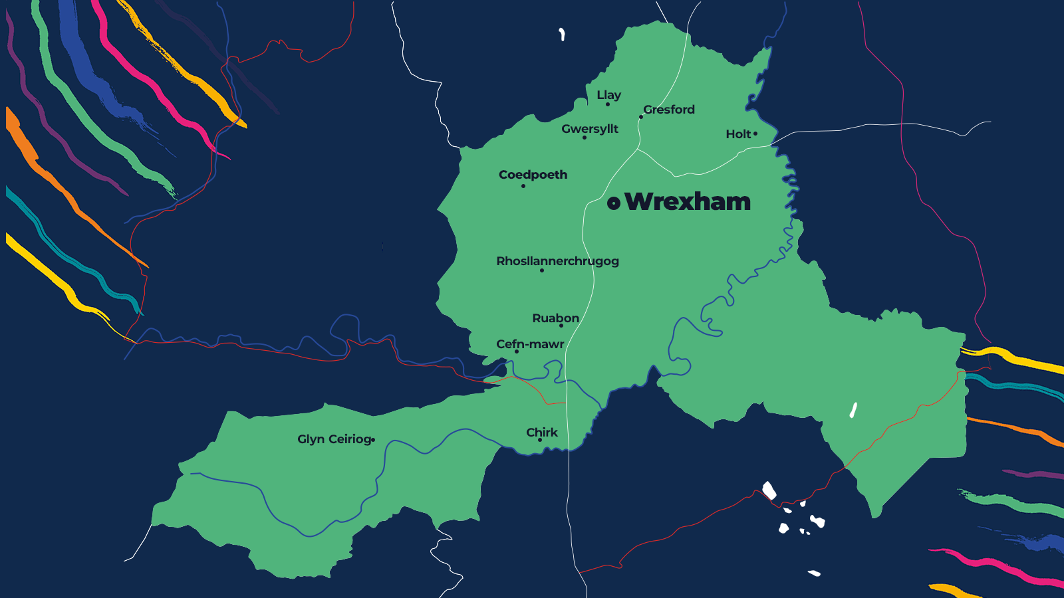























Results & analysis
We managed to speak to
11.97%
young people across Wrexham
and 425 people in total.
Notes:
In total , we spoke to almost 12% of Wrexhams young people aged 18-21. We know there are still many more to speak to, which is why WMTG are continuing their mission to find them.

Slide 23
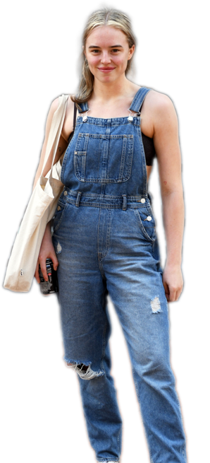
Findings
Language, message and reasoning are crucial to keeping them engaged.
Young people did not engage with us if they did not see a clear benefit for them.
Young people were not always where we expected them to be.
Reaching them involves understanding exactly where they might be, which was challenging at several points throughout the project.
The events from the past decade have impacted them greatly.
They did not always feel people around them understood how much.
Their habits, communication social engagement, professional expectations and goals have shifted.
They did not always fit with pre-covid expectations.
Notes:
Just conducting this research has taught us a lot about YP.
-They were often not where we expected them to be. We know now that we need to challenge pre-conceived ideas we may have about this age group.
- The language we use is curcial to keep them engaged- they are socially aware and more accepting of differences than any generation before them and if we don’t join them in this, we will lose them.
- They have been more impacted in different ways than we realise- they are trying to tell us but feel they are not being heard.
- They developed habits during lockdown that are not easy to break just because they are being told it’s time to go back to normal.

Slide 24
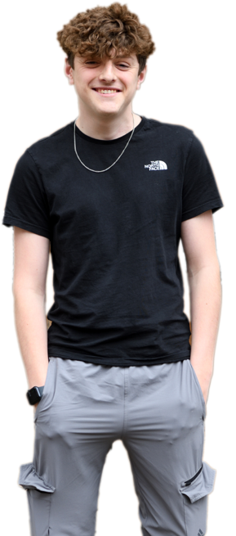
Findings
Motivation was at an all time low for many of them.
They felt they had missed out on an important part of their development and lacked support from people around them with power to make a change.
Happiness was often integral to their sense
of purpose.
Much of this was lost during and since the pandemic.
Many felt Wrexham did not always have the right support and infrastructure.
This would help them achieve their goals or even reassess them.
There was still a lot of positivity, many young people were inspiring and inspired.
They just felt they lacked the support they needed after the significant impacts that recent events had on their lives.
Notes:
While motivation was low in areas such as education and long term goal orientation, they are a group who do have aspirations. Speaking to those who did was inspiring for all of us. However, they often described that the right infrastructure is not in place for them to pursue their dreams. They are steered by traditional routes through education and they lack the confidence to do something different despite the drive to.

Slide 25

Who are the young people of Wrexham?
Audience personas
Notes:
Who are Wrexham’s YP?

Slide 26



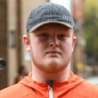






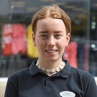








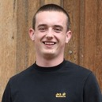





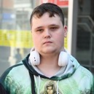





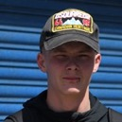

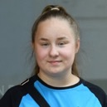








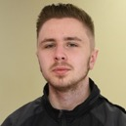


Notes:
As part of the research process, we develop ‘personas’ and these enable you to visualise the YP we’re talking about. We identified 5 specific personas you’ll hear a quote from each of them now.

Slide 27
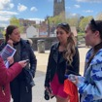
Social, but struggling
“I'd feel a bit anxious because when I get up in the morning sometimes, I feel like I don't want to go out the house but then I've got my friends and my loads of people to support me to come out the house so like I love doing that and all that and I just go shopping and play pool.”
Engage socially but might struggle with mental health
Pandemic let them feeling lost and daunted
Feel a lack of autonomy as their expectations and goals have had to shift
If employed, not often satisfied with their job.
Spent their free time with friends, or at home, online.
They feel lonely and misunderstood by older adults
Notes:
Despite appearing to be socially re-engaged- going to college and work, socialising with their friends- they are still struggling. Almost half (46%) of our young people told us that, since the covid pandemic, they felt more alone.

Slide 28
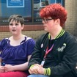
Diverse and disengaged
“We need leadership people that actually listen to the people because what is a city, what is a town, what is a village where you are in charge of people, when you don't actually listen to them? What's the point of having the responsibility of taking care of people when you do not actually look at what the people need?”
Strong identity to specific social groups and very accepting of diversity.
Feel let down and blamed by society, mistrust of older generations
Regular and cynical social media use
Driving mental health awareness and demanding more acceptance.
Missed out on learning opportunities
Unwilling to conform to traditional routes
Drawn towards careers in the public sector where they can make a change
Notes:
This group have openly lost interest in the systems they’re part of. 34% of our young people told us that they had lost interest in education since the pandemic. This persona identifies with very specific groups that they feel part of.

Slide 29

Resilient and self-reliant
(the side hustler)
“I work, like, as a freelancer. I can just work whenever I want to work so that's nice. And this is how I've got this really good niche job, because I'm finding more interest in the stuff that's not about education anymore.”
Have emerged more resilient from the pandemic
Used to living in uncertainty
Don’t want to conform to old norms, finding creative and entrepreneurial ways to make money
Engage with social media for their own ends
Politically savvy and aware of current affairs, critically engage with information presented to them
Champion diversity and inclusion
Notes:
Many of the young people we spoke to had hobbies that they were turning into money-making schemes and over half said they wanted to access professional support.

Slide 30
Let down and just living
“We just need somewhere we can have more places to take the kids because at the end of the day it's ...it's just full of crime... it's disgusting.”
Often unemployed
Feel like they might never get work and have given up trying
Cost of living crisis has hit them hard
Occasionally young parents, if not, main worries are how to provide for the people around them
More likely to turn to illegal activity and engage in risky behaviours
Also feel let down and don’t trust institutions around them
Notes:
Almost one in three young people we spoke to said they had given up on things they once enjoyed since the covid pandemic.

Slide 31
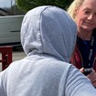
The COVID cohort
“You’re really lucky to speak
to her today, she very rarely goes out. She’s always at home with me.”
This is the group we engaged with directly the least
Usually described by their peers
Often at home, rarely socialise
Struggling with residual mental health issues from the pandemic
Often not registered in school or working, or don’t attend if they are
Heavy online presence
Do not seek help, traditional routes don’t feel accessible
Notes:
This is the group we engaged with the least. Before I play the recording, I just want to point out that with this young lady, her mum told us that she refuses to walk to college by herself and we’re very lucky to speak to her as she rarely leaves her house.

Slide 32
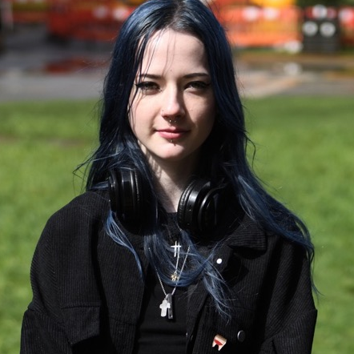
What is different about this research?
Introducing behaviour change
Notes:
So, what is different about our research?
We’re behaviour change experts. We apply robust, testable theories of human behaviour to help us to support behaviour change for social good.

Slide 33
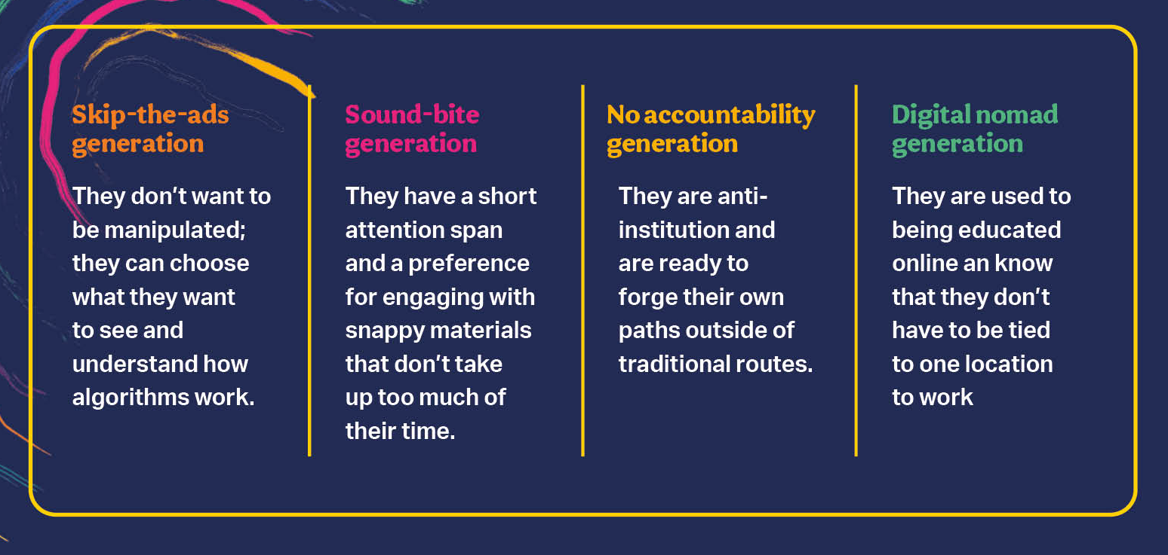
Notes:
So, what is different about our research?
We’re behaviour change experts. We apply robust, testable theories of human behaviour to help us to support behaviour change for social good.

Slide 34
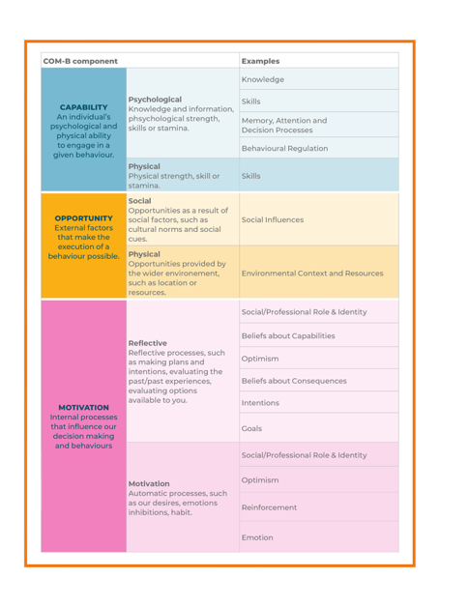
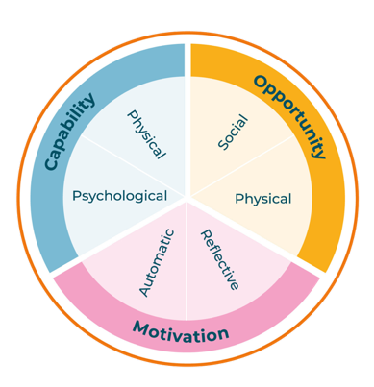
The COM-B model of behaviour change
Notes:
If you read through the research report you’ll see that we have applied the COM-B model of behaviour change and the associated behaviour change wheel. Simply, the COM-B model tells us we need three things for behaviour to occur.

Slide 35
The COM-B model of behaviour change
Notes:
The first thing we need is capability. This comes in the form of psychological capability (e.g., knowledge and awareness). In our research we identified that young people lack self-efficacy in their ability to do some of the things they need to do to return to normal. Capability also comes in the form of physical capability- this is the ability to actually perform the behaviour. In our research we saw that most young people are, in fact, physically able to perform behaviours that will result in positive outcomes but they have other barriers.

Slide 36
The COM-B model of behaviour change
Notes:
Next the COM-B model tells us that we need opportunity. This is in the form of social opportunity- (e.g., support from family, friends, professionals and positive social norms). This was very problematic in our young people- they did not feel that the right support was available for them to pursue the things they want to do. It also comes in the form of physical opportunity and, while many young people expressed that there were services out there, they were often inaccessible or inappropriate. There was a strong interaction between social and physical opportunity.

Slide 37
The COM-B model of behaviour change
Notes:
Finally, we need motivation. This comes in the form of automatic motivation- habits, emotions, identify, for example. Young people told us that they had developed habits during COVID which they had been unable to break- communicating only online, scrolling through social media and spending long periods alone. We also need motivation in the form of reflective motivation- this is things like goals and intentions. And in our young people we see a very clear reflective motivation barrier in that they are often directionless and have lost the drive for traditional education and employment.
So, in the full report, we’ve mapped the themes that were identified from the research onto this model and this has allowed us to make some recommendations for intervention development.

Slide 38
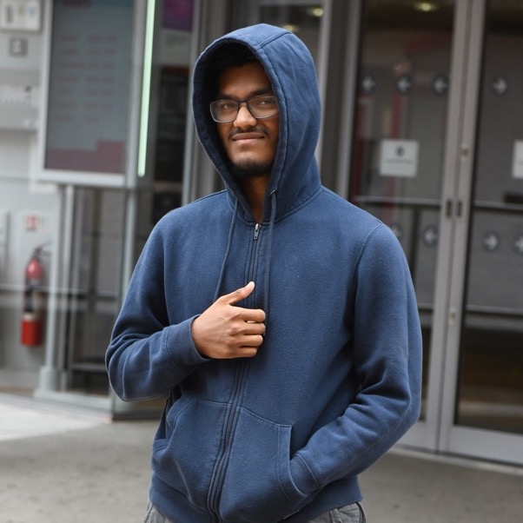
End of a chapter, start of a new one
Recommendations & next steps
Notes:
We have now put forward some recommendations to WeMindTheGap for some things that are in their power to implement and other things which are not.

Slide 39
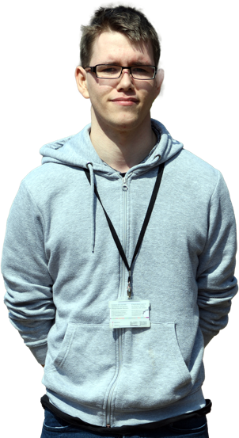

End of a chapter, start of a new one
Six months ago, we launched the Big Conversation, and today marks the end of the first phase.
We wanted to find who the young people of Wrexham were, where they were and what they needed.
So… now what?
Notes:
The goal is to continue the mission to change the lives of 1000 young people in 1000 days. We need to keep speaking to young people and we need to engage them in co-designing interventions that are fit for purpose.

Slide 40

Young people have taught us a lot
Many habits were formed, good or bad, during lockdown, and are now hard to break.
They did not come directly to us, we had to find them, and there are groups we did not manage to reach.
They are easily disengaged by the wrong type of language or agendas.
Their lives were widely impacted by COVID, and they sometimes feel older generations don’t realise that.
A lot of them are seeking a purpose, deeply correlated with happiness.
There has been a shift in the way they communicate and view the world.
Motivation is low, they need support as well as a challenge, something to work towards that aligns with their beliefs and values.
They want to feel understood and supported to make their own decisions, even if those don’t fit traditional expectations.
Notes:
One of the main things that we hope you can take away from this research is what we have learned about young people and how to engage them.
Play YP voices.

Slide 41
Recommendations
WMTG to partner with other organisations to develop an innovative ‘hub’ for young people in Wrexham. Whether the hub is a physical location (fixed), a community of people (mobile), or an online provision should be determined by consultation with young people
WMTG to partner with other organisations to develop a ‘reset intervention’ which enables young people to revisit the years of lost experience and learning that they would have had were it not for the COVID pandemic
WMTG currently offer services for young people to support them into work and education, but they are under-subscribed and are mainly implemented in the North of England. We recommend that WMTG ‘test’ the current model (including communication efforts, social media platforms, website, etc
An ‘explorer’ model was trialled during the research with limited success. However, it was likely that the young people we recruited to implement this model were being asked for quite a large commitment with little commitment in return

Slide 42
Thank you
Questions?

